Slide 1
DATA LOGGING WITH PYTHON
SAYALI MATE 112003083
MIHIKA SANGHVI 112003084
DIv:1
Batch: S5

Slide 2
DESCRIPTION:
We are reading temperature and humidity using DHT-11 sensor through Arduino board.
The temperature and humidity at the given time is seen on the LED.
With python we store all the data shown on the LED onto the database.
MYSQL connectivity is used for this purpose.
The change in temperature and humidity every second can be seen in the database.
AIM:
The aim of our project is to store the varying temperature and humidity values so that it can be used for analytical purposes.

Slide 3
HARDWARE AND SOFTWARE USED
HARDWARE
Arduino board
DHT 11 sensor
LCD
Breadboard
Cables
Potentiometer
USB cable
SOFTWARE
PYTHON:
1)MySQL(Database)
ARDUINO

Slide 4
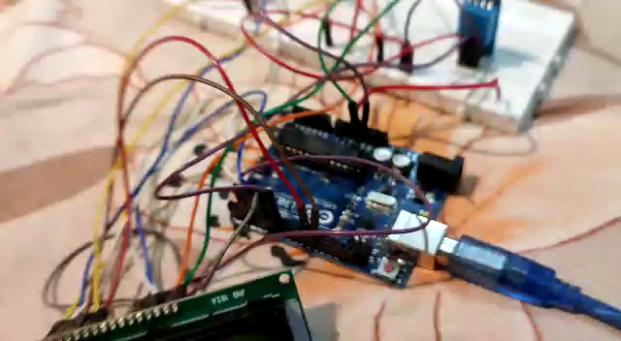
PROJECT DEMO

Slide 5
THANK YOU!!

